Slide 1
Design and Study of a Human-Human Interaction System to Control the Movement of Paralyzed Hand
Presented by
Ankita Giroti
M. Sc. Semester III
Under the Guidance of
Dr. Mrs. A. D. Sakhare
Department of Electronics and Computer Science,
Rashtrasant Tukadoji Maharaj Nagpur University, Nagpur

Slide 2
ESP-NOW Protocol
ESP-NOW is a wireless communication protocol based on data link layer
Designed by Espressif
It is used to transfer data packets between two ESP devices
The protocol allows paired devices to communicate directly without any Wi-Fi connection or third-party device
ESP-NOW uses MAC address of the device to which it wants to send data packets

Slide 3
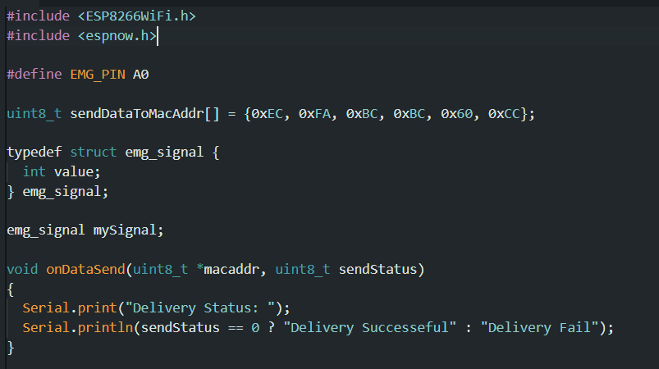
Experimental Work
Read EMG values and sending to other ESP8266

Slide 4
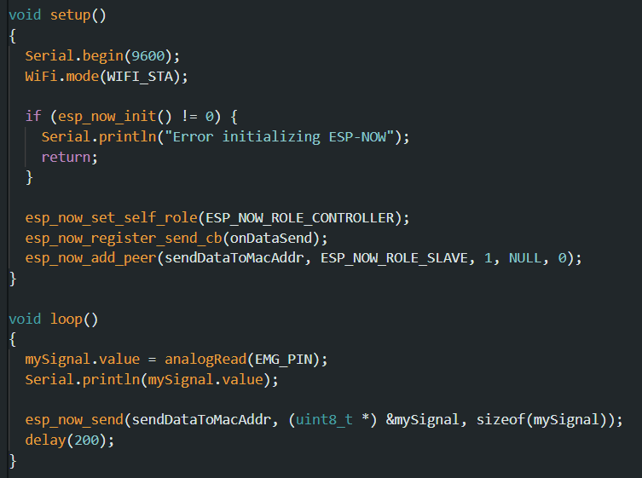

Slide 5

Rotating servo motor on other ESP8266 by reading EMG data

Slide 6
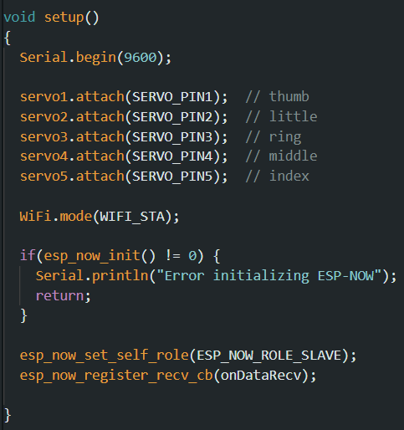
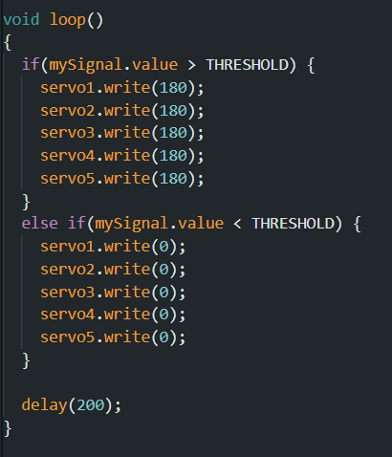

Slide 7
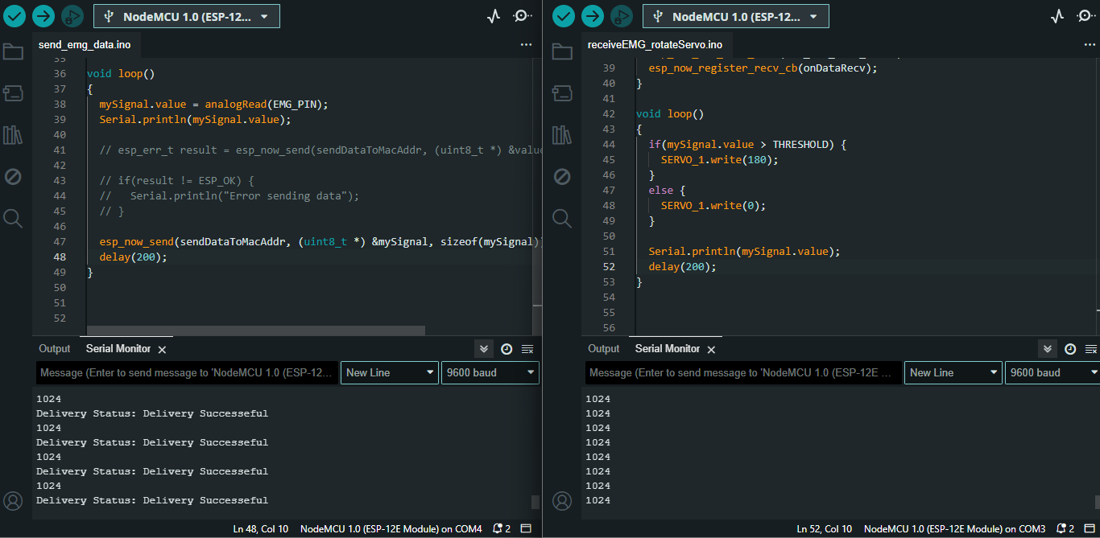
Output

Slide 8
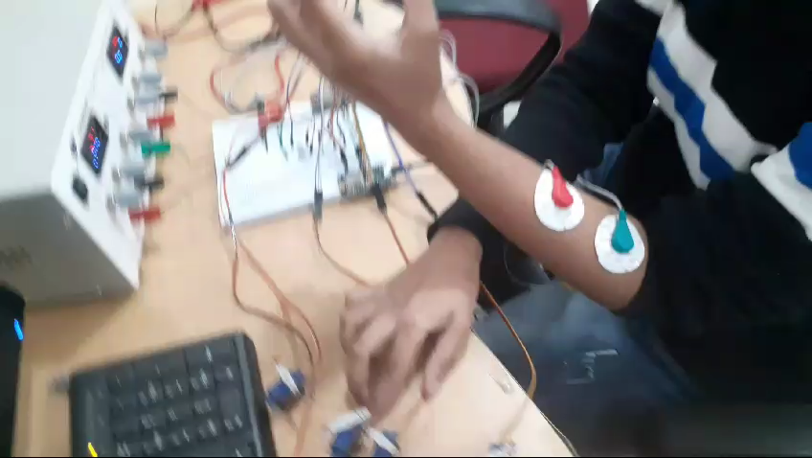
Output

Slide 9
Thank You

